Slide 1
WEB APPLICATION INFRASTRUCTURE
Albert Casas, Ehimare, David Nsoesie, Anthony Gillis

Slide 2



Why IAAS is Important
Infrastructure as a service allows companies to:
Hosting, Deploy and Manage apps
Use resources from the service provider (Amazon, Microsoft, and Google)

Slide 3
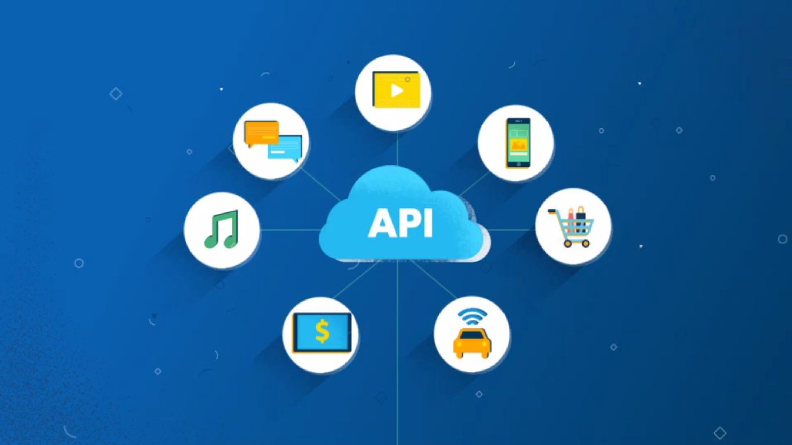
REST API’s
An API is a set of rules that lets programs talk to each other.
REST (Representational State Transfer) is an architectural pattern that describes how distributed systems can expose a consistent interface.
Benefits include:
Stateless client/server protocols
A Uniform interface
Allows use of hypermedia
Notes:
An API is an application programming interface - in short, it’s a set of rules that lets programs talk to each other, exposing data and functionality across the internet in a consistent format (Mahesh). REST stands for Representational State Transfer. This is an architectural pattern that describes how distributed systems can expose a consistent interface. When people use the term ‘REST API,’ they are generally referring to an API accessed via HTTP protocol at a predefined set of URLs. These URLs represent various resources - any information or content accessed at that location, which can be returned as JSON, HTML, audio files, or images. Often, resources have one or more methods that can be performed on them over HTTP, like GET, POST, PUT and DELETE. (Mahesh)
There are a few very useful advantages to using and building Rest Api’s, some more useful than others. Rest Api’s feature
Stateless client/server protocols
Object manipulation from the URI/URL
A Uniform interface
A Layer system
Use of hypermedia
For developers it provides a few key advantages:
Separation between the client and the server.
Visibility, readability and scalability
The Api is independent of the type of platform or languages

Slide 4
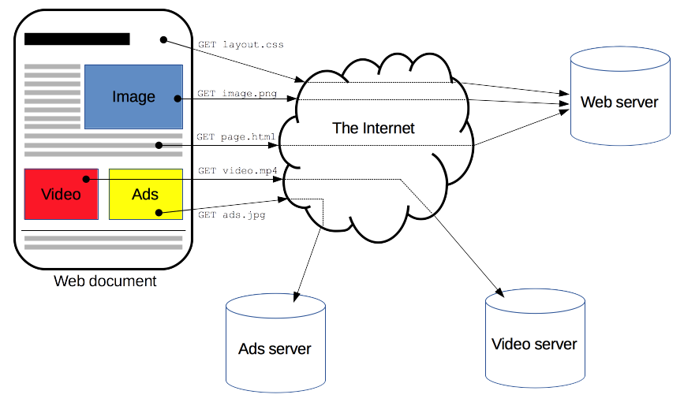
HTTP
HyperText Transfer Protocol HTTP is a protocol which allows the fetching of resources, such as HTML documents.
Clients create requests
Messages from server a responses
Notes:
Albert

Slide 5
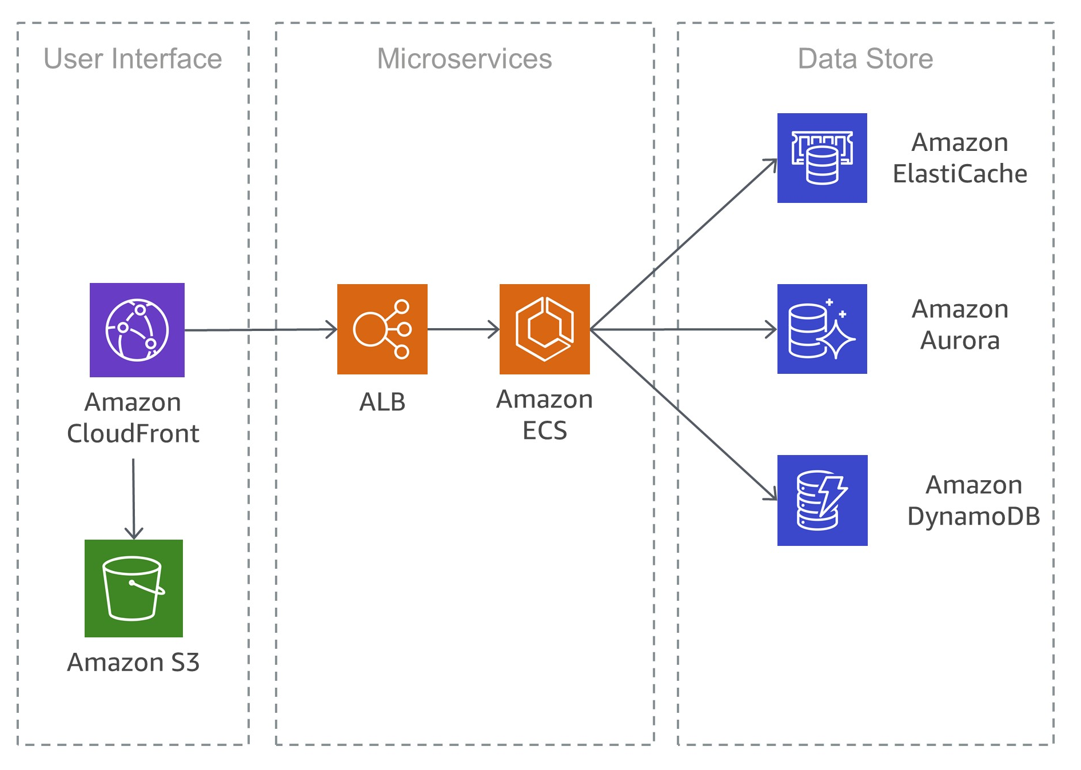
Backend Infrastructure
Typical monolithic applications are built using different layers—a user interface (UI) layer, a business layer, and a persistence layer. A central idea of a microservices architecture is to split functionalities into cohesive “verticals”
Notes:
David

Slide 6
Application screenshots

Slide 7
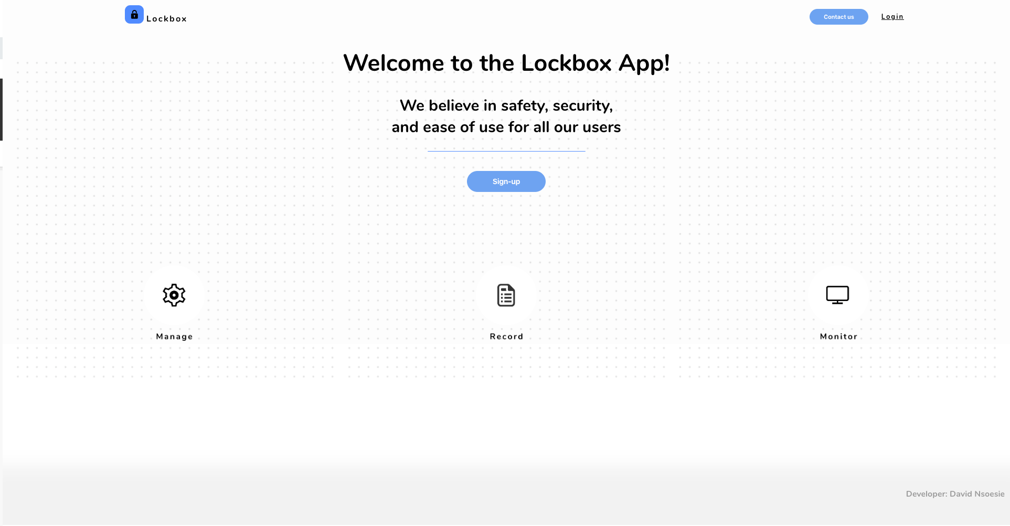
Landing Page

Slide 8
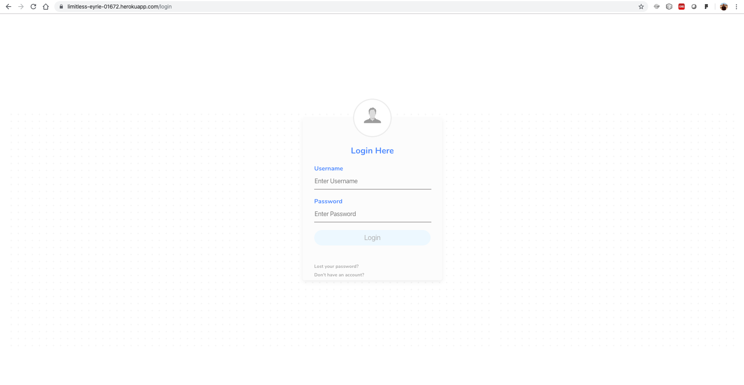
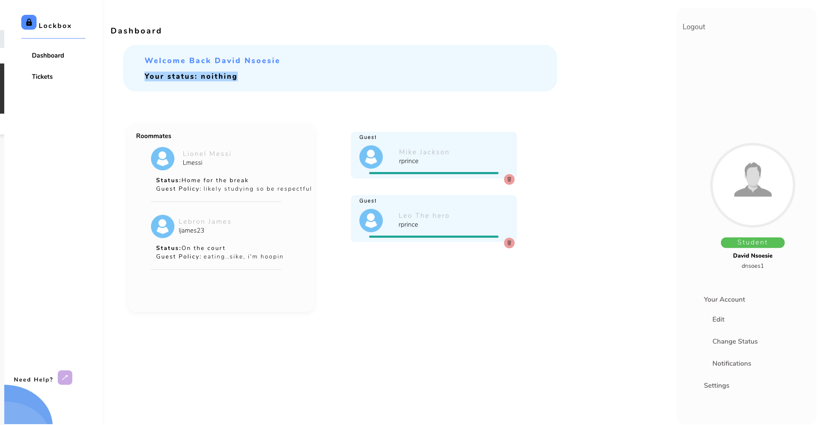
Login page
Student Dashboard

Slide 9
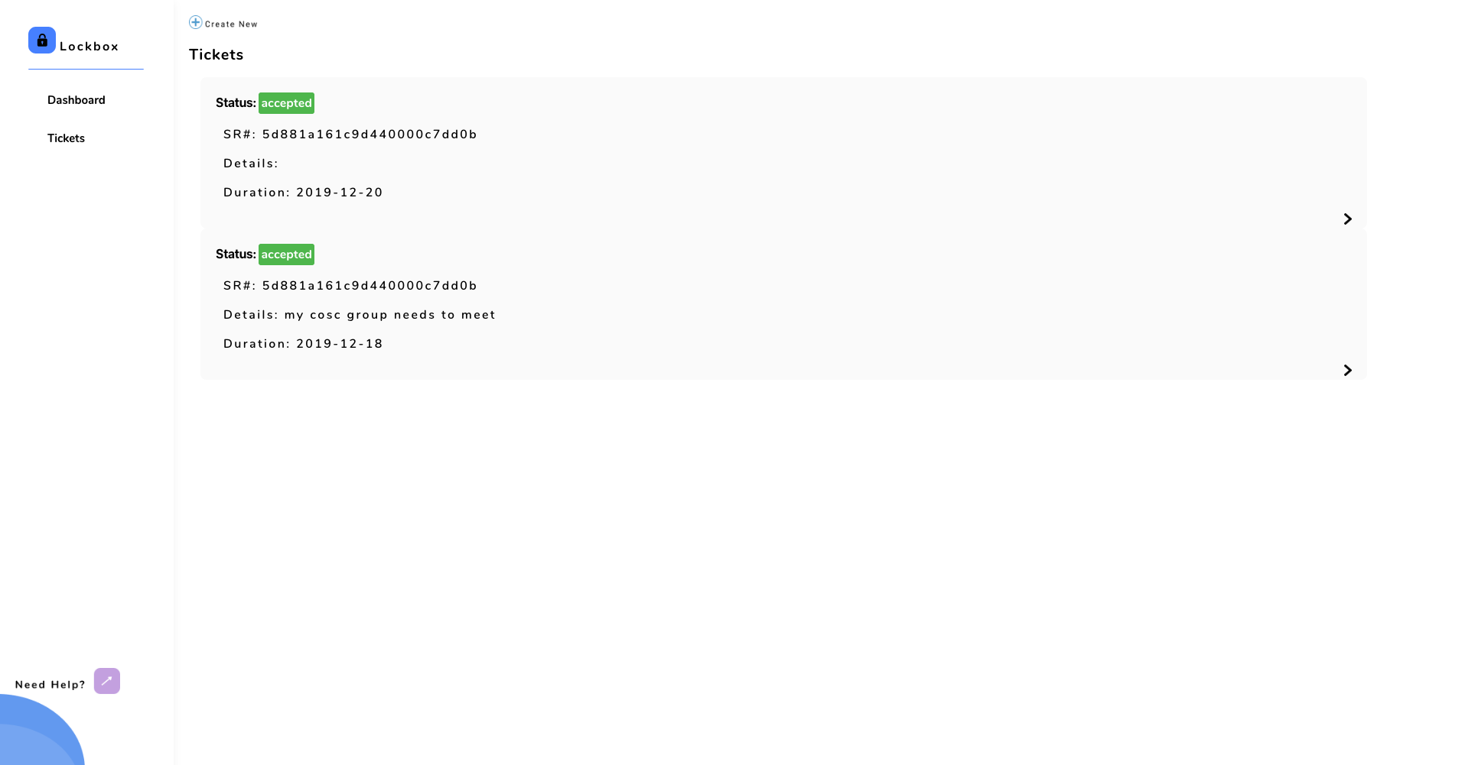
Tickets page

Slide 10

Example response from the API

Slide 11
LockBox Demo
Notes:
David

Slide 12
Conclusion
With increasing competition between companies in the digital space, New businesses will need to improve their technology to compete. Recently, this has been increasingly easier to do due to:
IAAS
APIs
HTTP
Improved Backend Infrastructure

Slide 13
References
“An Overview of HTTP.” MDN Web Docs, https://developer.mozilla.org/en-US/docs/Web/HTTP/Overview.
BBVAOpen4U. “REST API: What Is It, and What Are Its Advantages in Project Development?” BBVAOpen4U, 23 Mar. 2016, https://bbvaopen4u.com/en/actualidad/rest-api-what-it-and-what-are-its-advantages-project-development.
Haldar, Mahesh. “RESTful API Designing Guidelines - The Best Practices.” By, https://hackernoon.com/restful-api-designing-guidelines-the-best-practices-60e1d954e7c9.
HTTP/1.1: Request, https://www.w3.org/Protocols/rfc2616/rfc2616-sec5.html.
Richardson, Chris. “Building Microservices Using an API Gateway.” NGINX, 8 Feb. 2019, https://www.nginx.com/blog/building-microservices-using-an-api-gateway/.
“Whitepapers.” Amazon, Earthpledge Foundation, https://docs.aws.amazon.com/whitepapers/latest/microservices-on-aws/simple-microservices-architecture-on-aws.html.

